Slide 1
TBI PATIENTS: ANALYSIS
ALY6080 – Final Project Presentation
Submitted by Shivi Jain
Naina Gupta Mehak Gagneja Divya Pai
Professor
Dr. Mimoza Dimodugno

Slide 2
TABLE OF CONTENTS
Executive Summary
Business Problem
Methodology
Data Warehouse
Data Cleaning
Data Visualization
Data Modelling
Findings and Recommendations
Future Scope

Slide 3
INTRODUCTION
Traumatic brain injury (TBI) is a highly complex and heterogeneous disorder of the central nervous system (CNS), which is rapidly emerging as one of the leading causes of death and disability worldwide
Our project examines the distinct variations in symptoms of Traumatic Brain Injuries (TBIs) based on demographic factors and developing a database to facilitate access to data records for key attributes

Slide 4
EXECUTIVE SUMMARY
The main elements of this project are:
Data warehouse with all the reported data provided by the sponsors
Tableau Dashboards giving an exploratory insight into the reported data warehouse
Two Predictive models including:
A Decision Tree model to predict the feature importance and the trajectory of variables
A Random Forest model to further increase the accuracy and prediction of decision trees
Goal: To extract valuable insights from the complex dataset and inform decision-making processes related to TBI symptoms and patient demographics

Slide 5
BUSINESS PROBLEM
To improve operations, we:
Need to create a structured Data warehouse to readily access patient data at any given time
Need to gain valuable insights to enhance treatment strategies and improve patient outcomes based on demographics
Need to understand if there is any correlation between TBI symptoms and key patient demographics such as age and gender

Slide 6



METHODOLOGY
Create a database to
store the data and
reference files
Clean the data to
enhance effectiveness
of data analysis
Develop interactive
dashboards to draw
insights
Build classification
models & compare
their performance

Slide 7
DATA WAREHOUSE
30 data files and 8 reference files containing structured, unstructured, and narrative data in CSV format
Tables created with referential constraints like primary keys, foreign keys, and not null constraints to establish a framework for structuring data in data warehouse.
Data from the files were imported into their corresponding tables in an SQLite DB browser
Objective: To enable efficient querying and data- accessibility from the data warehouse

Slide 8
DATA CLEANING
Challenges:
Data collected from the Sallie app was recorded with default options for variables
Users could also enter custom inputs and provide additional details, leading to more than 30 unique values for variables
Long descriptive entries in many columns, hard to interpret
Users often described similar conditions using different words
Solution:
Prompting the grouping of variable values into a smaller number of distinct categories using reference tables as the master data
Managing Null entries such that data- quality is not compromised
Objective: Improve data analysis efficiency, identified patterns, reduced redundancy, and enhanced the overall structure of information in the warehouse

Slide 9
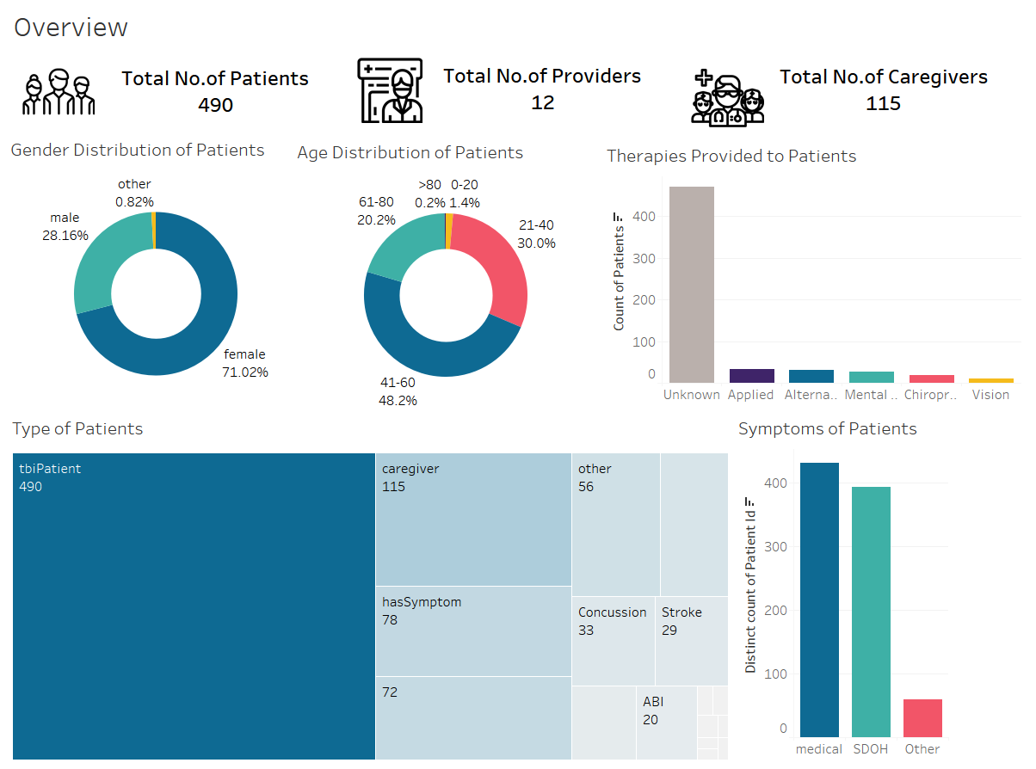
DATA VISUALIZATION
The first dashboard captures an overview of the general distribution of Patients, their age, symptoms, and the therapies being provided to them

Slide 10
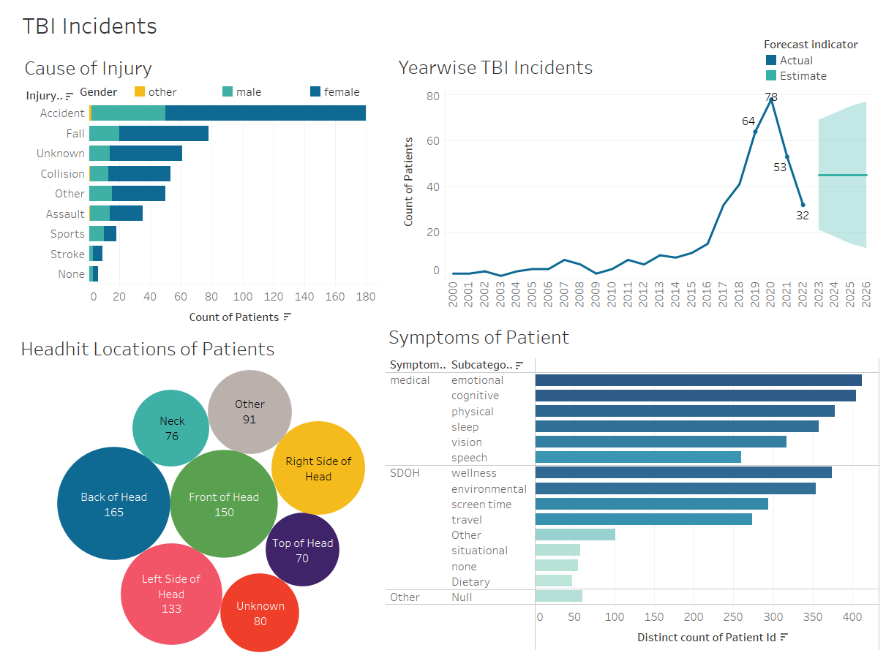
DATA VISUALIZATION
This dashboard captures the information on cause of injuries, head hit locations in TBI patients, growth in number of TBI patients over years and symptom categories

Slide 11
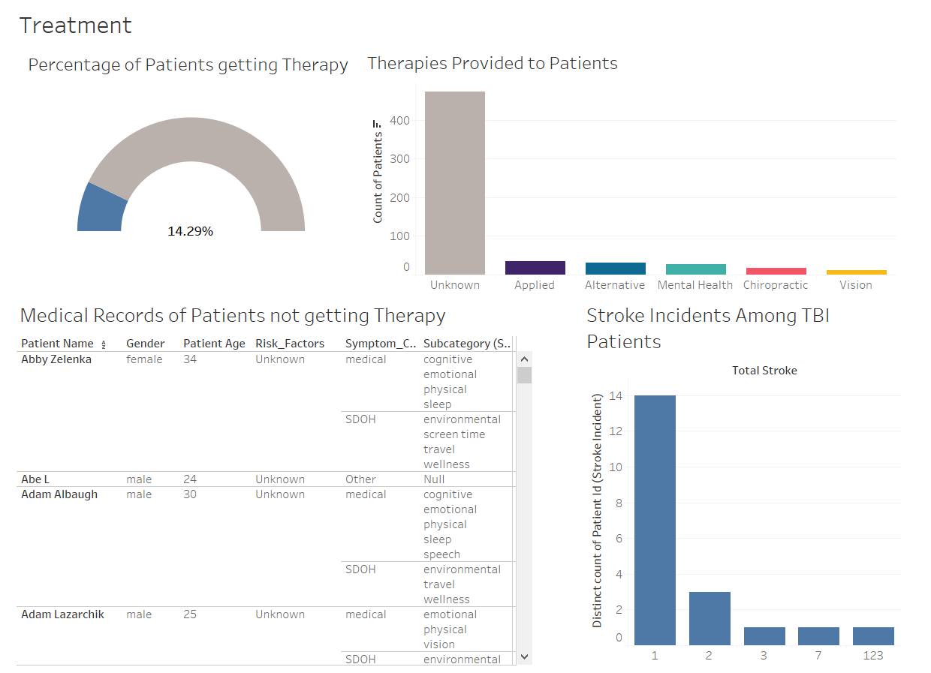
DATA VISUALIZATION
This dashboard captures the information highlighting the treatment for TBI patients, including percentage of them getting therapy, different types of therapies, their medical records as well as the stroke incidents

Slide 12


PREDICTIVE MODELS
To predict gender of TBI in patients based on all other factors
Gender information can then be used to develop targeted intervention strategies, personalize treatment plans, and improve patient outcomes in the context of TBI treatments provided

Slide 13
DECISION TREE MODEL
The features that are considered most important in predicting the gender of a TBI patient are Age, Race, head-hit location, and Sleep subcategory.
Model Performance: Demonstrated an accuracy of 87.41%, indicating reasonably good overall performance
Metrics | Accuracy | Sensitivity | Specificity | Precision
Decision Tree Model | 87.41% | 94.66% | 68.27% | 88.73%

Slide 14
RANDOM FOREST MODEL
The features deemed important in predicting the gender of the patient are Age, cause of injury, Race, and the head hit location.
The age factor is important to predict females only till 69.5 years of age as per the final decision tree of the random forest model
Model Performance: Demonstrated good overall performance with an accuracy of 91.28%
Metrics | Accuracy | Sensitivity | Specificity | Precision
Random Forest Model | 91.28% | 98.85% | 71.30% | 90.09%

Slide 15
FINDINGS AND RECOMMENDATIONS
71% recorded TBI patients are females; TBIs are more common among females assuming that the sample is unbiased
50% TBI patients belong to 41-60 years of age; need efforts to understand specific issues faced by individuals in this age range
Accidents are leading cause of TBIs among both genders, followed by Collision and Assault; need efforts to provide immediate care on the incident locations
TBIs are more prevalent after 21 years of age, so need targeted awareness- programs for young adults
Applied, alternative, and mental therapies are most common; Future research focus needed on evaluating effectiveness of these therapies and their integration into treatment plans

Slide 16
FINDINGS AND RECOMMENDATIONS
Observed fall in TBI records since 2020, presumably due to COVID outbreak; Reveals importance of direct patient contact in TBI conditions
Only ~14% of the recorded patients are currently receiving therapy for their TBI-induced conditions
Majority patients are experiencing Medical symptoms more than Social Determinants of Health-related symptoms
Majority of TBIs are caused due to hitting on the Backside, Front side and Left side of the head
Age, cause of injury, Race, and head-hit location are most important factors predicting gender of TBI patient, however age loses relevance as a predictor of gender beyond 68-69 years of age
Both models showed promising results in predicting ‘female ‘class; Random Forest model performed better

Slide 17
FUTURE RESEARCH
Models can be further refined and utilized for identifying risk factors, predicting treatment outcomes, or assisting in personalized patient care
Analyze factors for higher prevalence of TBIs among females, including gender-specific risk factors like lifestyle to provide insights into underlying causes & help develop targeted prevention strategies
Study long-term patient outcomes of physical/cognitive functioning, emotional well-being, and social integration to improve rehabilitation programs and support systems
Assess effectiveness of different therapies through controlled studies or clinical trials to evaluate the impact of specific interventions based on symptoms, age, and head-hit location
Explore virtual engagement & telehealth for effective TBI care, particularly during circumstances like COVID
Investigate the feasibility of establishing standardized protocols for data collection and reporting of TBI-related information across different healthcare settings

Slide 18
REFERENCES
Agoston, D. V., & Langford, D. (2017b). Big Data in traumatic brain injury; promise and challenges. Concussion, 2(4), CNC44. https://doi.org/10.2217/cnc-2016-0013
Belle, A., Thiagarajan, R., Soroushmehr, S. M. R., Navidi, F., Beard, D. A., & Najarian, K. (2015). Big Data Analytics in Healthcare. BioMed Research International, 2015, 1–16. https://doi.org/10.1155/2015/370194
Centers for Disease Control and Prevention (CDC). Traumatic Brain Injury & Concussion: Data and Statistics. Retrieved from https://www.cdc.gov/traumaticbraininjury/data/index.html
Nielson, J. L., Cooper, S. R., Seabury, S. A., Luciani, D., Fabio, A., Temkin, N. R., & Ferguson, A. R. (2021, September 15). Statistical guidelines for handling missing data in Traumatic Brain Injury Clinical Research. Journal of neurotrauma. https://pubmed.ncbi.nlm.nih.gov/32008424/
Traumatic Brain Injury (TBI). (n.d.-c). National Institute of Neurological Disorders and Stroke. https://www.ninds.nih.gov/health-information/disorders/traumatic-brain-injury- tbi
Taylor, C. A., Bell, J. M., Breiding, M. J., & Xu, L. (2017). Traumatic brain injury-related emergency department visits, hospitalizations, and deaths - United States, 2007 and 2013. Morbidity and Mortality Weekly Report, 66(9), 1-16.
Sun, J., Ahn, H., Palmer, R. F., Berry, C., Vadera, S., & Hariri, R. (2020). Predicting neurocognitive outcome using gradient boosting and electronic health records. NeuroImage: Clinical, 27, 102311. doi: 10.1016/j.nicl.2020.102311
Williams, W. H., & Evans, J. J. (2020). Traumatic Brain Injury. Oxford Research Encyclopedia of Psychology. Retrieved from https://oxfordre.com/psychology/view/10.1093/acrefore/9780190236557.001.0001/acrefore-9780190236557-e-324
Gravesteijn, B. Y., Nieboer, D., Ercole, A., Lingsma, H. F., Nelson, D. R., Van Calster, B., & Steyerberg, E. W. (2020a). Machine learning algorithms performed no better than regression models for prognostication in traumatic brain injury. Journal of Clinical Epidemiology, 122, 95–107. https://doi.org/10.1016/j.jclinepi.2020.03.005Links to an external site.
Liew, T. Y. S., Ng, J. J., Jayne, C. H. Z., Ragupathi, T., Teo, C., & Yeo, T. T. (2019). Changing Demographic Profiles of Patients with Traumatic Brain Injury: An Aging Concern. Frontiers in Surgery, 6. https://doi.org/10.3389/fsurg.2019.00037

Slide 19
THANKS!
Do you have any questions?

Slide 20
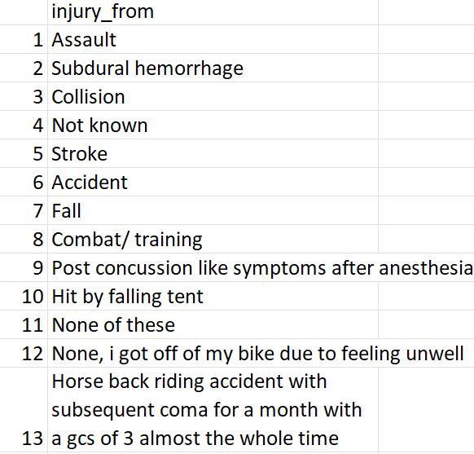
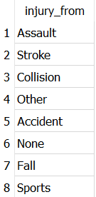
Appendix
Data Cleaning Example:
110 Unique values 8 Unique values

Slide 21
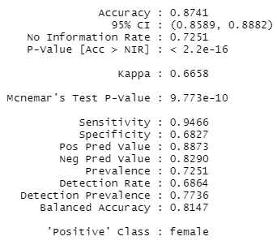
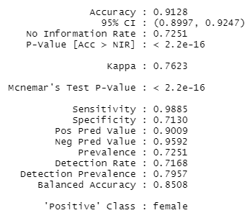
Appendix
Predictive Model Outputs:
Decision Tree Model Random Forest Model

